Slide 1
Calculating Family Expenses Using Service Now
SlideMake.com

Slide 2

Introduction to Calculating Family Expenses
This presentation explains how to use ServiceNow to manage and calculate family expenses efficiently.
ServiceNow offers automation tools that streamline expense tracking and reporting processes.
Accurate expense calculation helps families plan budgets and make informed financial decisions.
Notes:
Image source: https://thumbs.dreamstime.com

Slide 3
Overview of ServiceNow Platform
ServiceNow is a cloud-based platform used for service management and automation.
It provides customizable modules suitable for financial tracking and reporting.
The platform integrates well with various data sources for comprehensive expense analysis.
Notes:
Image source: https://www.servicenow.com

Slide 4
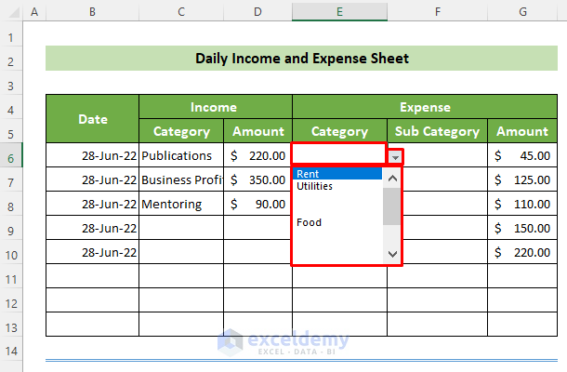
Setting Up Expense Categories
Create specific categories such as groceries, utilities, education, and healthcare within ServiceNow.
Use the platform’s configuration options to define expense types and associated parameters.
Proper categorization ensures accurate tracking and easier reporting of family expenses.
Notes:
Image source: https://www.exceldemy.com

Slide 5

Inputting Family Expenses
Expenses can be entered manually or automatically via integrations with bank accounts and payment systems.
Use forms and templates to standardize data entry for consistency.
Regularly update the expense records to maintain current and accurate data.
Notes:
Image source: https://img.freepik.com

Slide 6
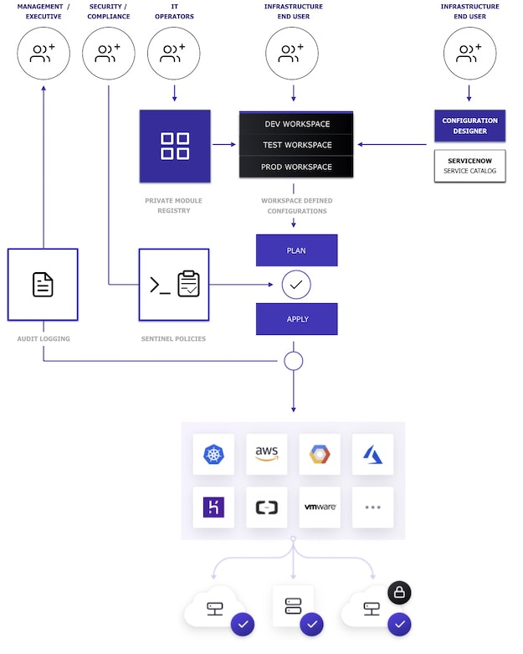
Automating Expense Calculations
Utilize ServiceNow’s workflow and scripting capabilities to automate expense aggregation.
Set up rules to calculate totals, averages, and categorize expenses automatically.
Automation reduces manual errors and saves time in expense management.
Notes:
Image source: https://www.datocms-assets.com

Slide 7
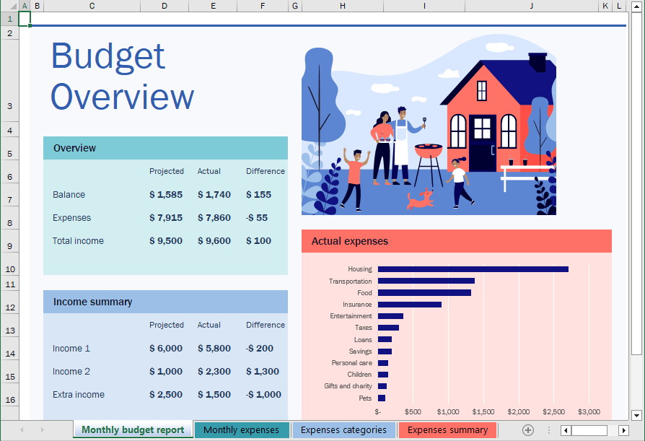
Analyzing Expenses and Budgeting
Generate reports and dashboards to visualize spending patterns over time.
Compare actual expenses against budget limits to identify potential savings.
Use insights from analysis to adjust family budgets proactively.
Notes:
Image source: https://www.officetooltips.com

Slide 8

Sharing and Collaborating on Expense Data
Share reports and dashboards with family members for transparency and input.
Configure permissions to control access to sensitive financial information.
Collaboration encourages collective financial responsibility and planning.
Notes:
Image source: https://img.freepik.com

Slide 9
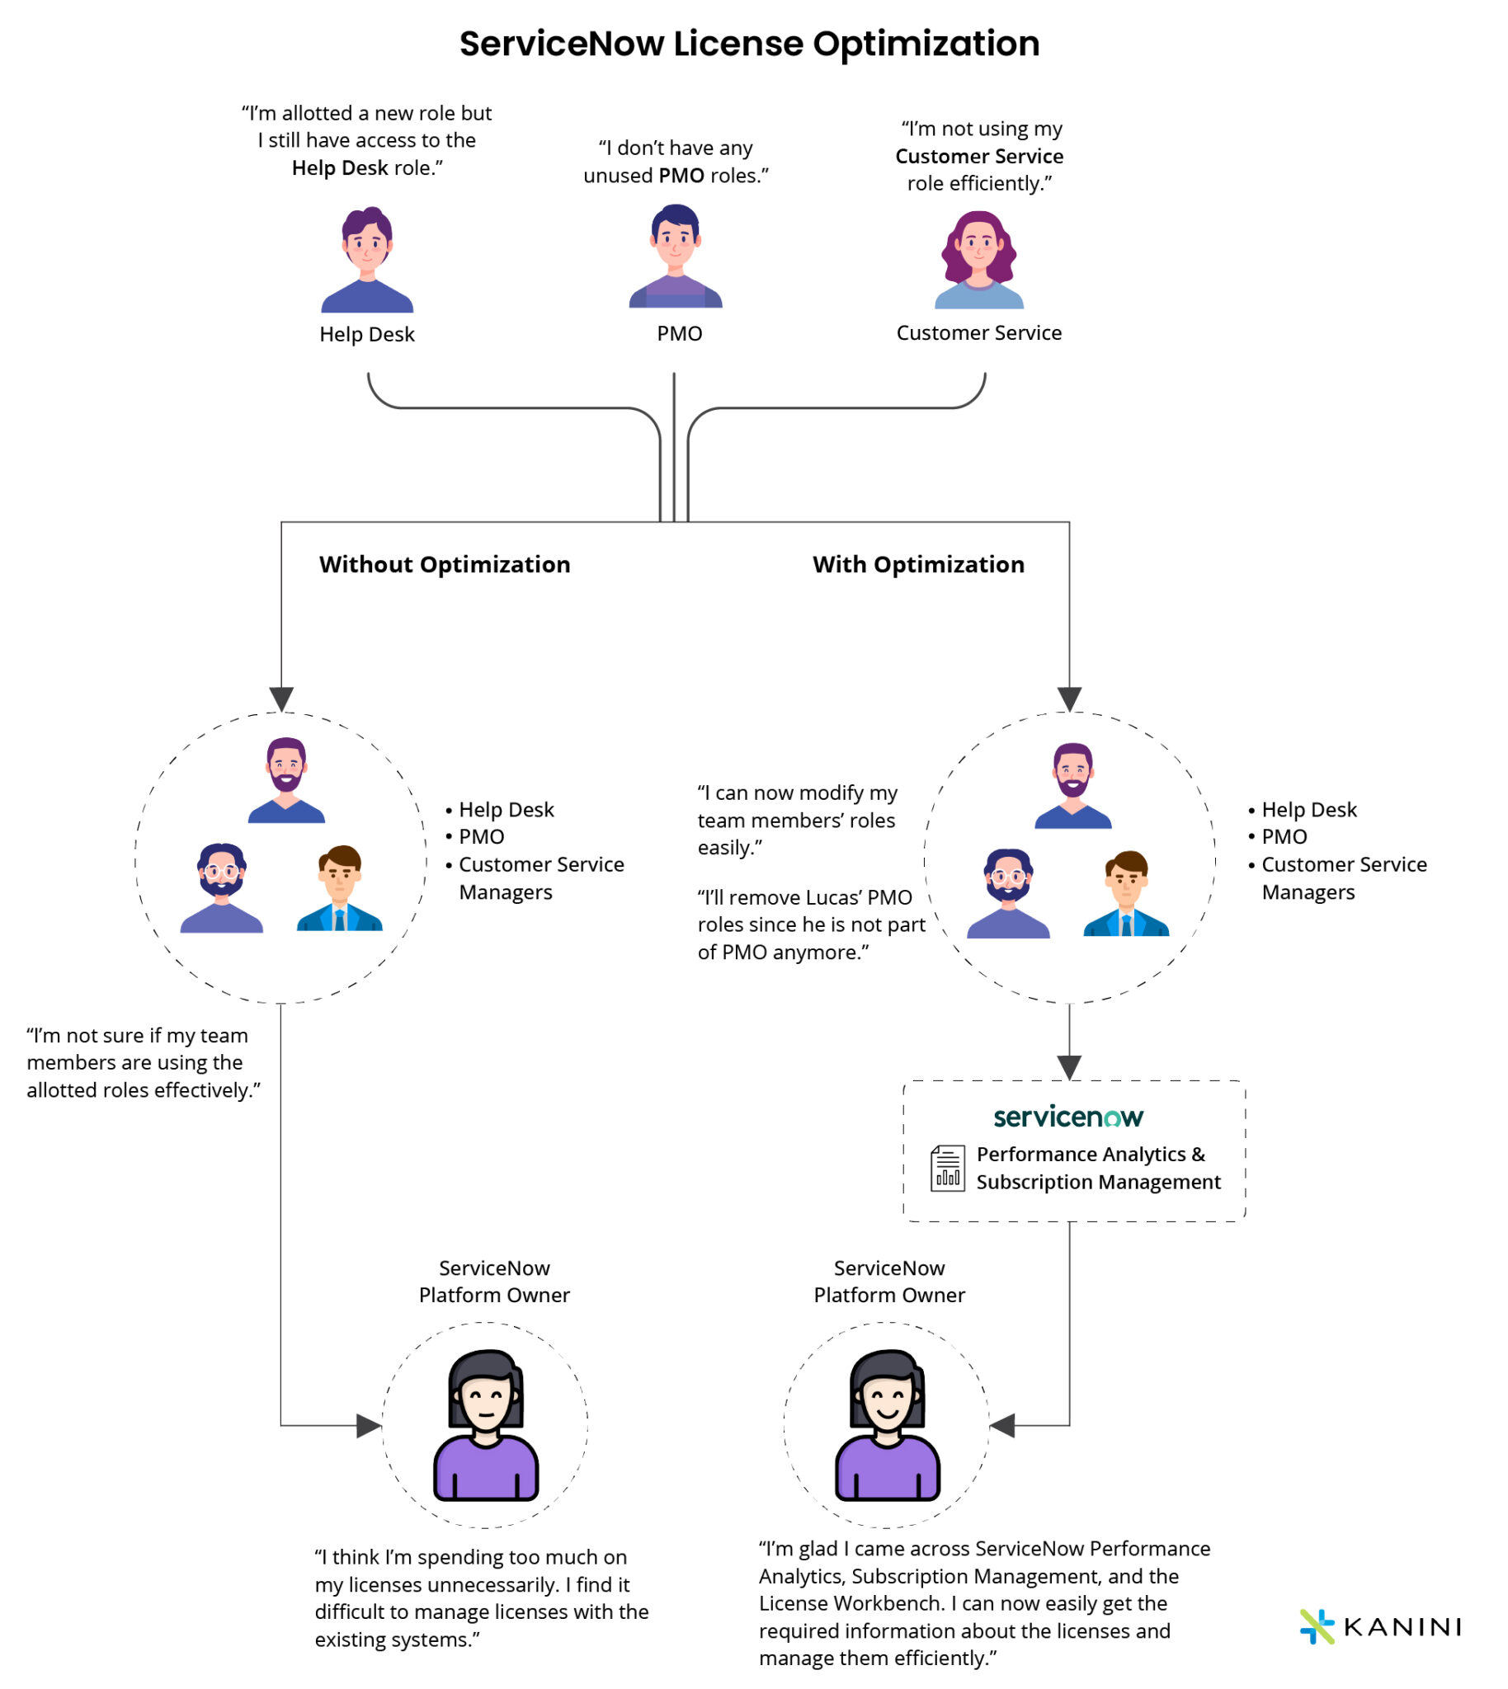
Conclusion and Benefits
Using ServiceNow for family expense calculation simplifies financial management.
The platform’s automation and reporting features improve accuracy and efficiency.
Proper expense tracking supports better budgeting decisions and financial stability.
Notes:
Image source: https://kanini.com

Slide 10
References
ServiceNow Official Documentation. (2023). Managing Financial Data.
Financial Planning Resources. (2022). Budgeting and Expense Tracking.
Expert Articles on ServiceNow Automation and Reporting.

